Slide 1

Effects of Swirl Injector Design on Hybrid Rocket Fuel Regression Rate
(Grain Development)
Team Members: Raul Lugo, Kyle Bowerman
Mentor: Matthew Summers

Slide 2
Research Overview
Background
  Hybrid Rocket Propulsion
  Swirl Injectors
  Regression Rate
Grain Development
  Sizing
  Formulation
  Mixing and Casting

Slide 3
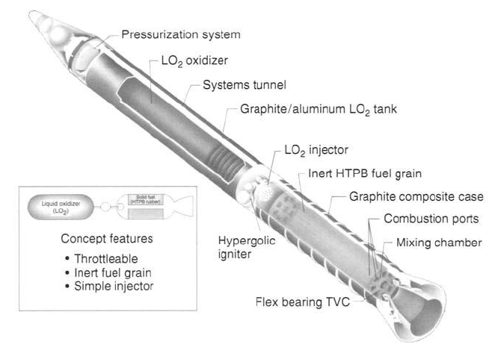
Background: Hybrid Rocket Propulsion
Propellant in solid and liquid phases
Fuel type: Hydroxyl-terminated polybutadiene (HTPB) in solid state
Oxidizer type: Nitrous oxide (N₂O) in liquid state
Precombustion chamber
  Where atomization occurs
Postcombustion chamber
  For proper combustion

Slide 4
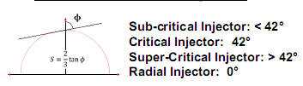
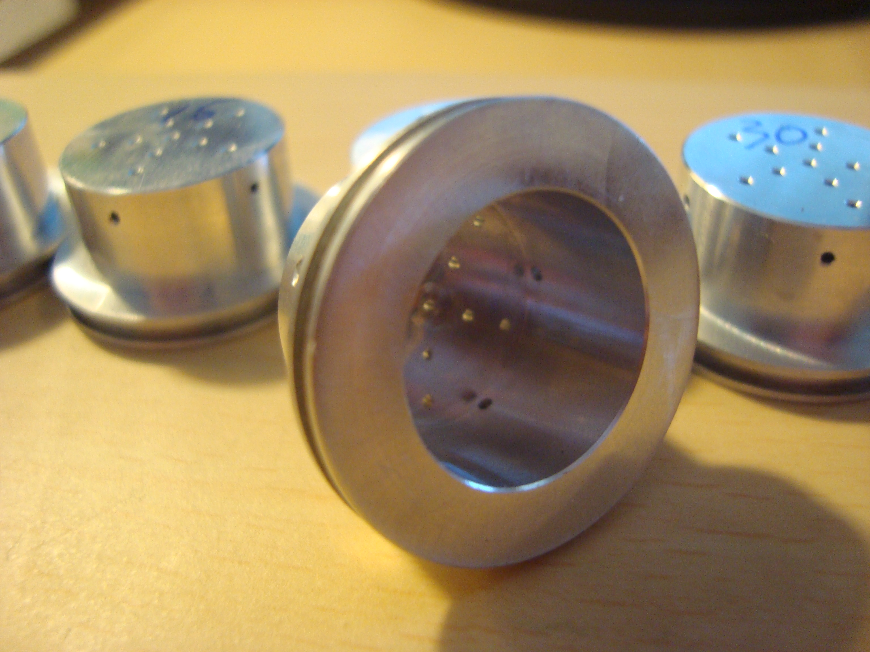
Background: Swirl Injectors
Create a central toroidal recirculation zone (CTRZ)
  Improves regression rate
  Creates stable combustion
Classification
  S = Swirl number
  Φ = Swirl angle

Slide 5

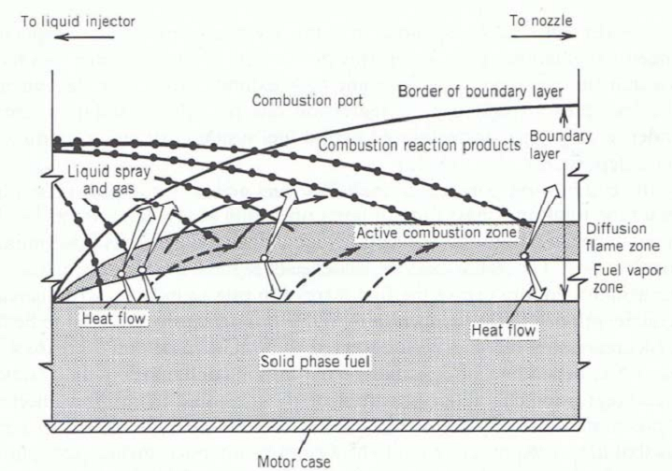
Background: Regression Rate
Regression rate is the amount of solid hybrid fuel that is receding from the surface during combustion along the length of the cylindrical grain.

Slide 6

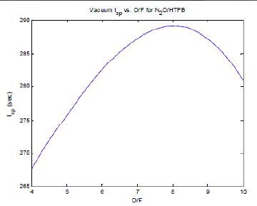
Grain Development: Sizing
L = length of grain
N = number of ports
m_{f} = fuel mass flow rate
R_{i} = Initial
ρ_{f} = fuel density
r = regression rate
O/F = oxidizer to fuel ratio
I_{sp} = specific impulse

Slide 7
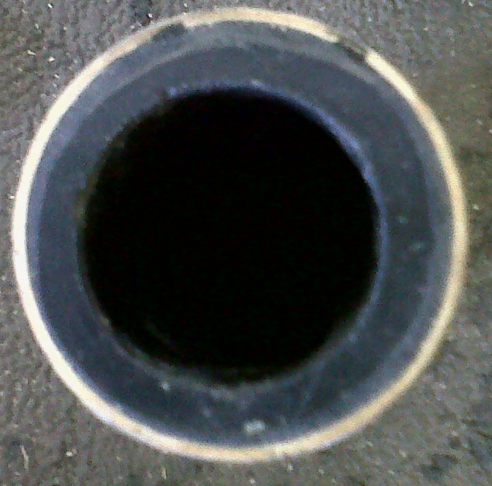
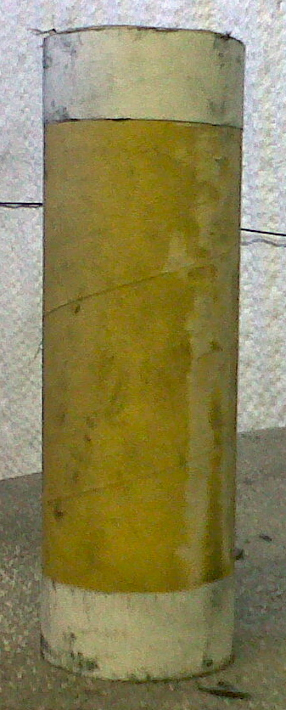
Grain Development: Sizing
1.5 in
2.25 in
O/F | 8
a | 0.1296
n | 0.778
r_dot | 0.0283 (m/s)
m_ox | 0.25 (lb/s)
m_f | 0.0313 (lb/s)
ρ_{HTPB} | 0.0336 (lb/in³)
I.D. | 1.5 (in)
O.D. | 2.25 (in)
L | 7 (in)
7 in

Slide 8
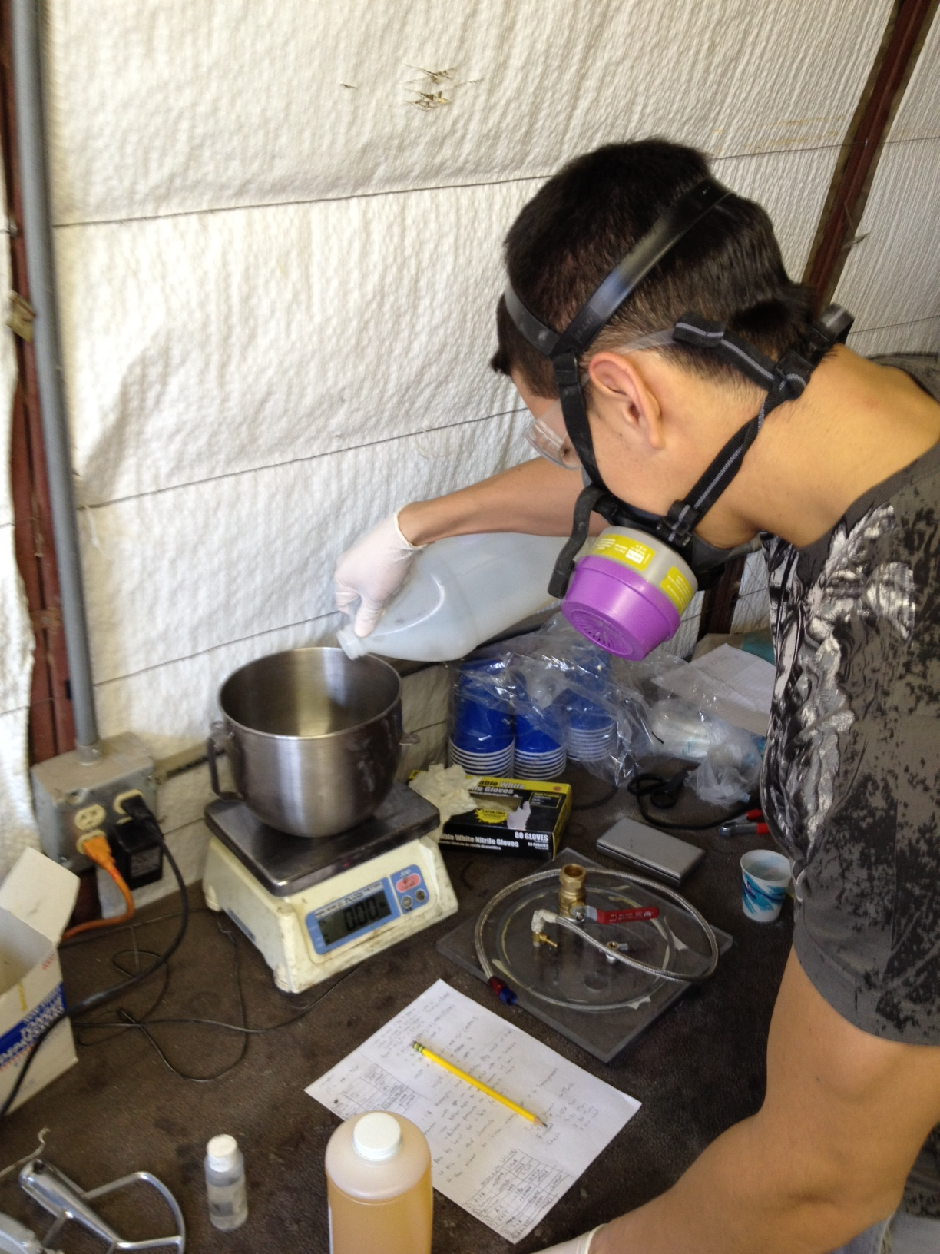
Grain Development: Formulation
Liquid HTPB = Fuel
Isonate 143L = Curative
Silicon Oil = Lubricant
Carbon Black = Opacity
Amount | Chemical/Additive
85% | HTPB
15% | Isonate 143L
2 teaspoons | Carbon Black
N/A | Silicon Oil

Slide 9
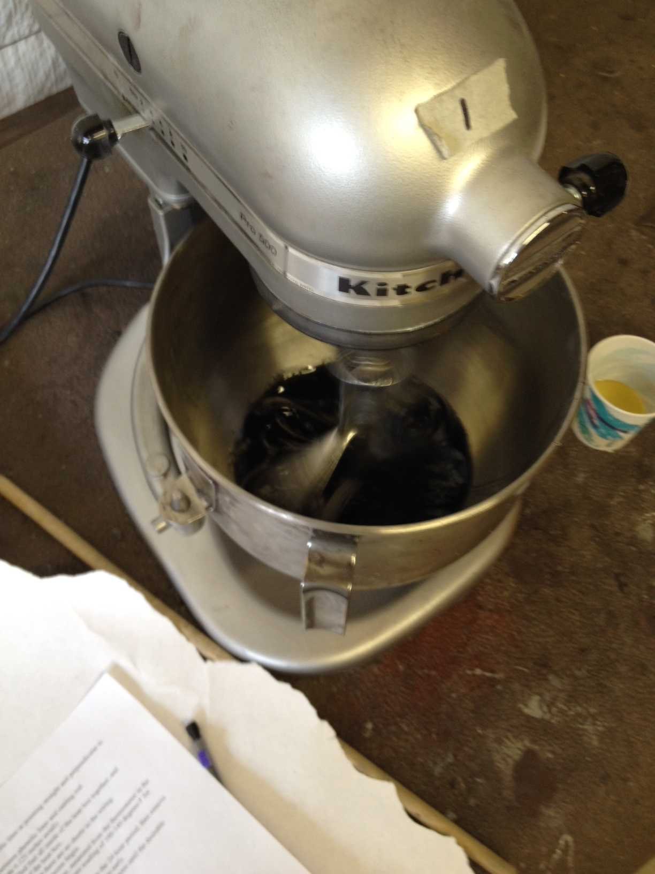
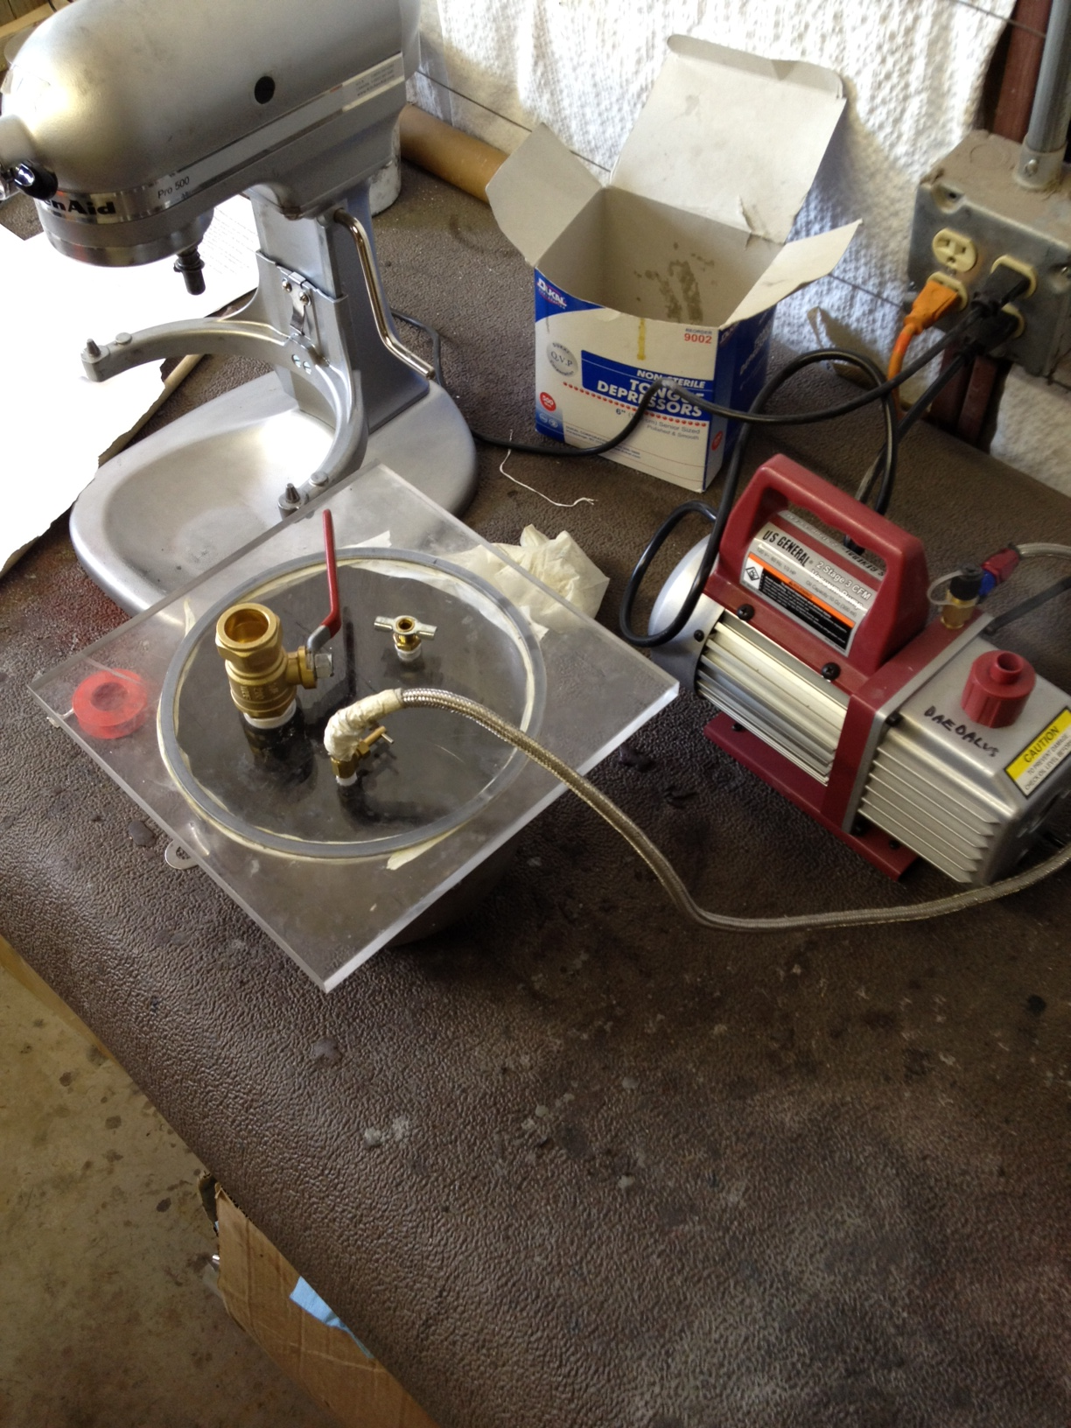
Grain Development: Mixing and Casting
Mixing of formulation
  Used a Kitchen Aid stand mixer
Vacuuming
  To ensure no air pockets when pouring into cast
Relief Valve
Polycarbonate Sheet
Vacuum Pump
Mixing Bowl

Slide 10
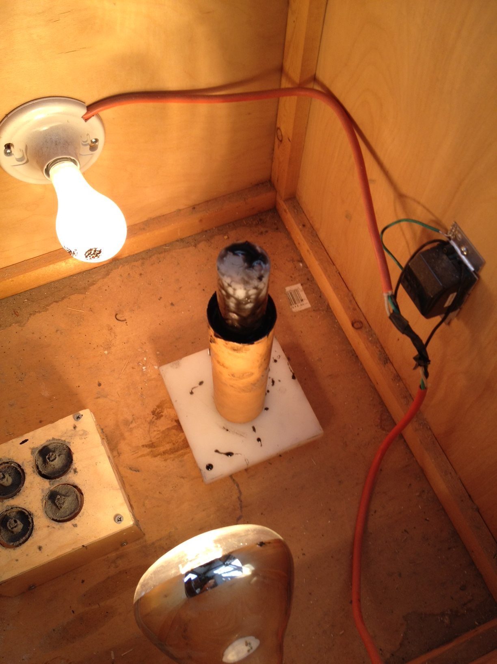
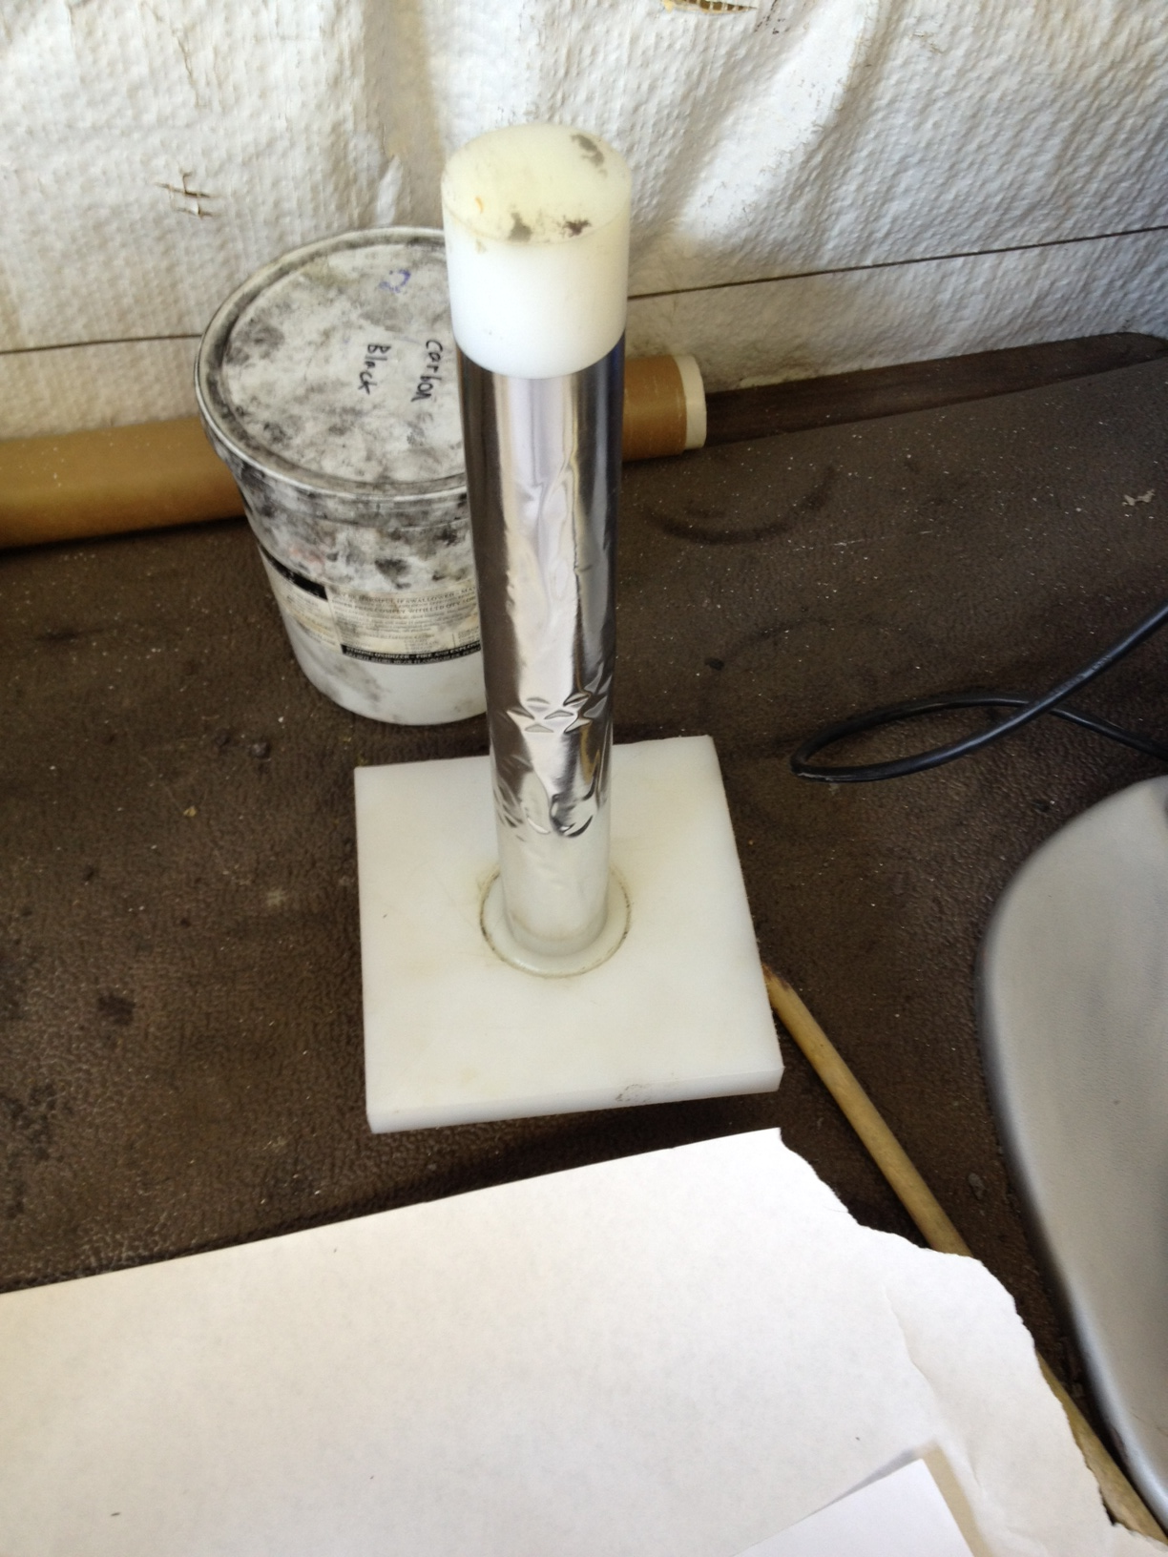
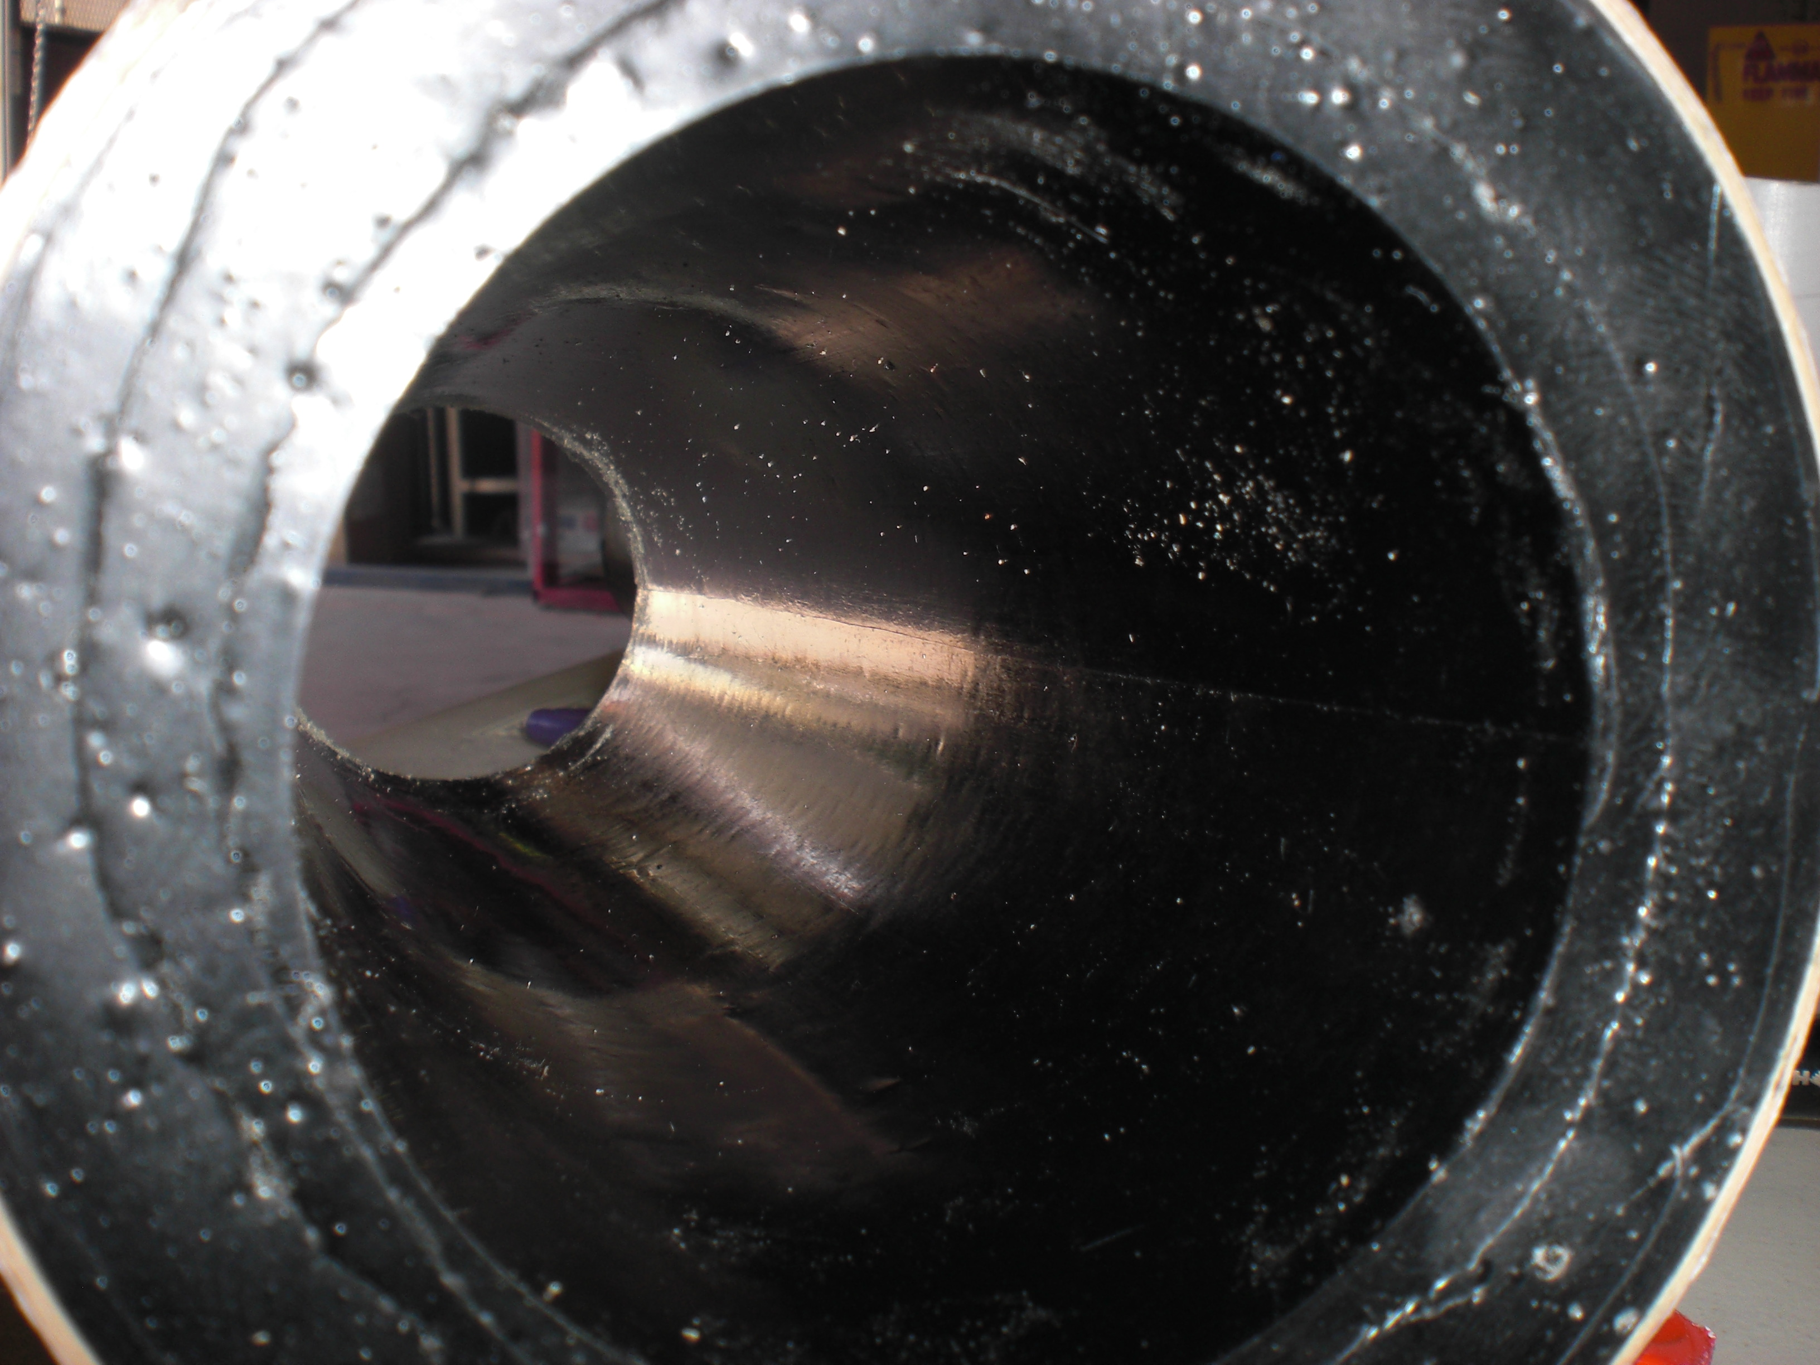
Grain Development: Mixing and Casting
Mylar sheet coated with mold release
24 hour curing process
Heat box heated from 100–140 degrees F
Casting rod
Mylar
Heat box
Cured grain
Phenolic liner

Slide 11
Future Plans
Develop multiple grains for multiple fire tests in a day
Improve grain development process
  Mix and cast multiple grains at once
  Improving time for development
Regression rate analysis of aluminum addition in formulation
Analysis of other fuel grains ex. paraffin

Slide 12
Acknowledgements
ASU/NASA Space Grant Consortium
Raytheon Company
Matthew Summers (Mentor)

Slide 13
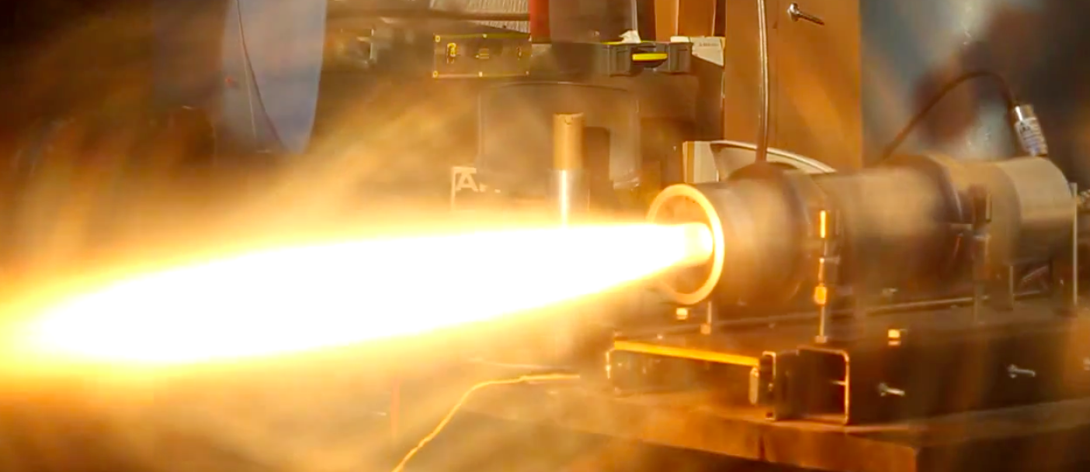
Thank you.
Any Questions or Comments?

